Slide 1

Time varying covariates in a Cox model
Steve Simon for
Notes:
Analyzing Repeated Measures Data Workshop: Module 5 The Linear Mixed Model
Copyright 2011 The Analysis Factor http://TheAnalysisFactor.com
1

Slide 2
Abstract
Lecture 6.
Time varying covariates allow you to account for non-proportional hazards and can model settings where patients switch from one therapy to another. You will code data for time-varying covariates, fit time-varying models, and interpret the results.

Slide 3
Testing the proportional hazards assumption
Several approaches
Patterns in Kaplan-Meier curves
Complementary log-log plot
Schoenfeld Residuals
Stratified analysis
Fit time varying covariates

Slide 4
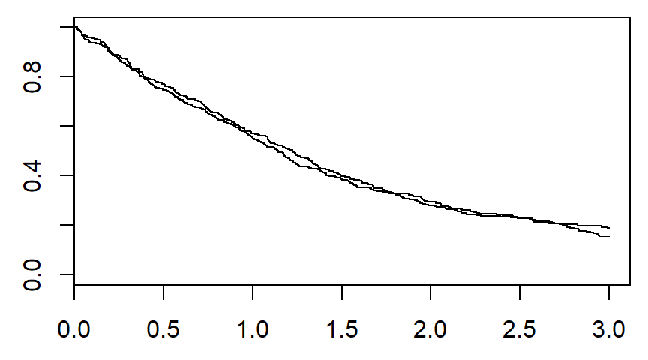
Patterns in the Kaplan-Meier curves

Slide 5
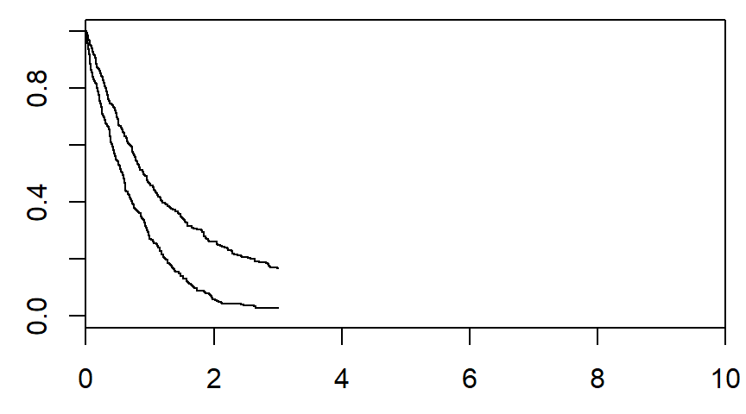
Patterns in the Kaplan-Meier curves

Slide 6
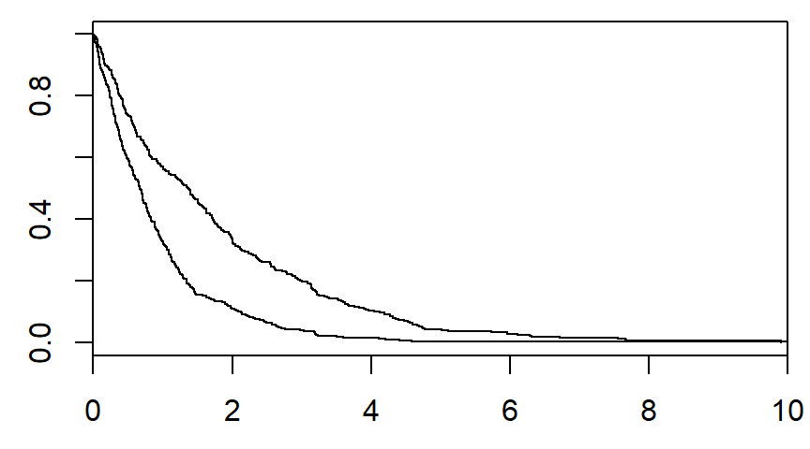
Patterns in the Kaplan-Meier curves

Slide 7
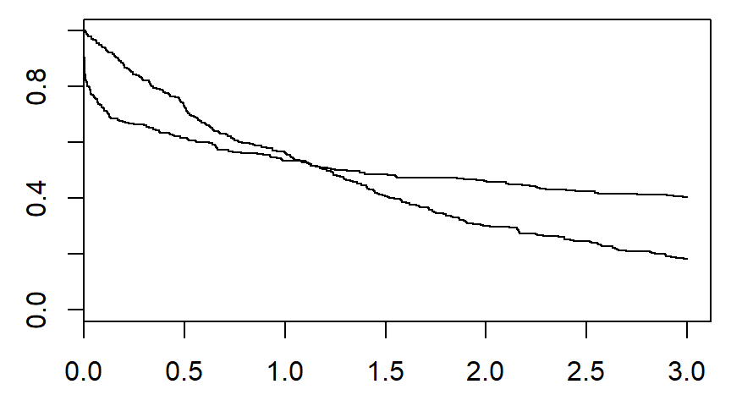
Patterns in the Kaplan-Meier curves

Slide 8
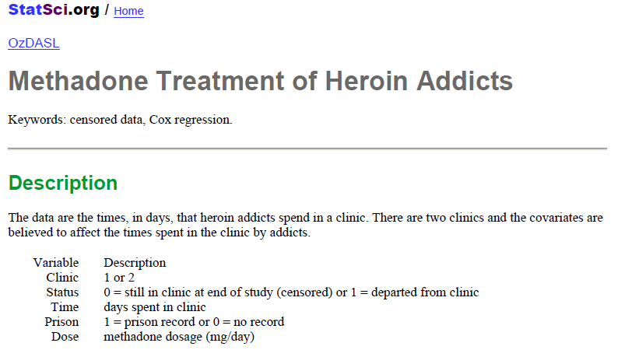
Example: heroin clinic discharge times

Slide 9
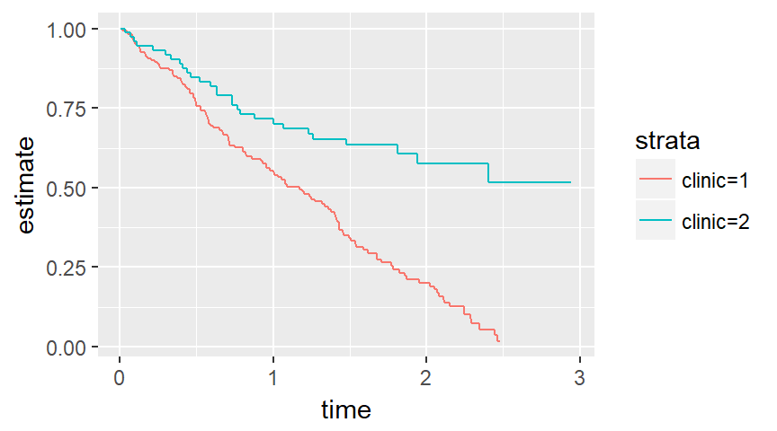
Example: heroin data set.

Slide 10
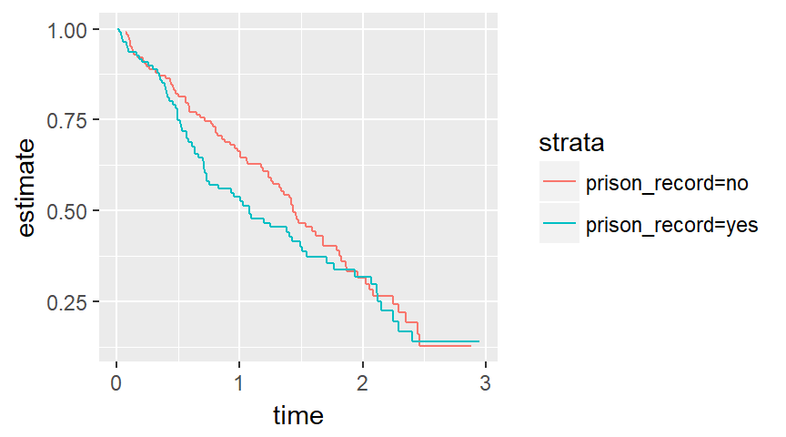
Example: heroin data set.

Slide 11
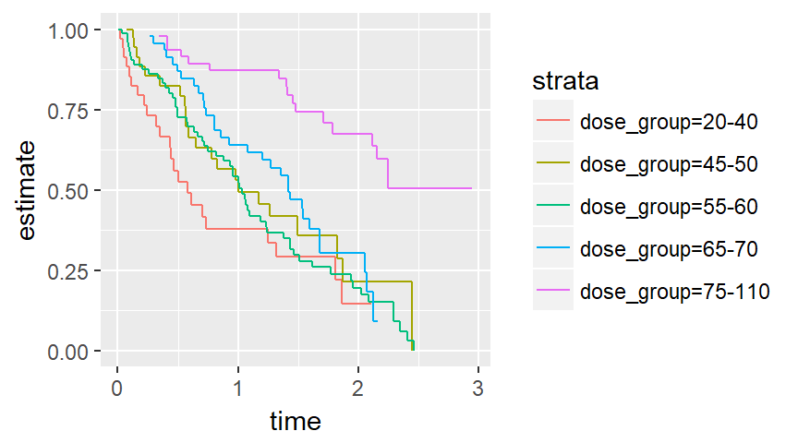
Example: heroin data set.

Slide 12
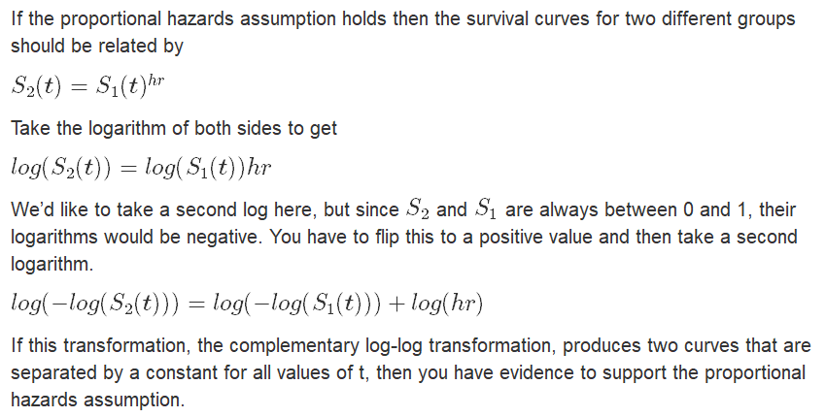
Complementary log-log

Slide 13
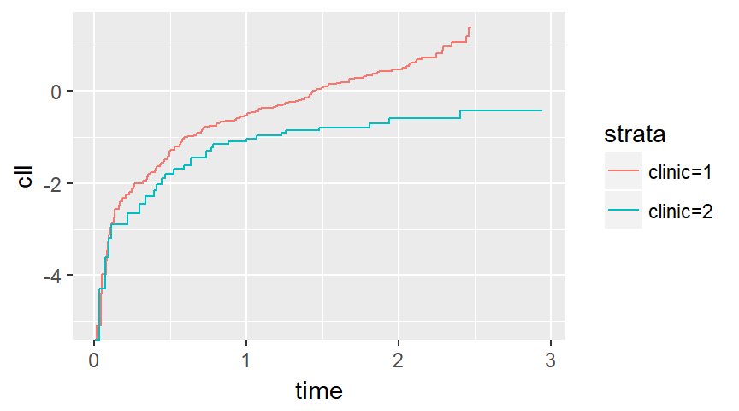
Complementary log-log

Slide 14
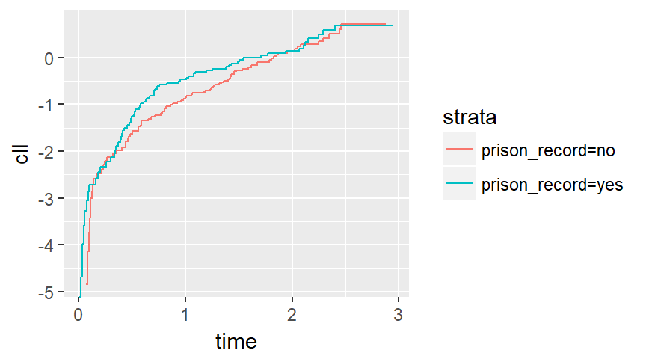
Complementary log-log

Slide 15
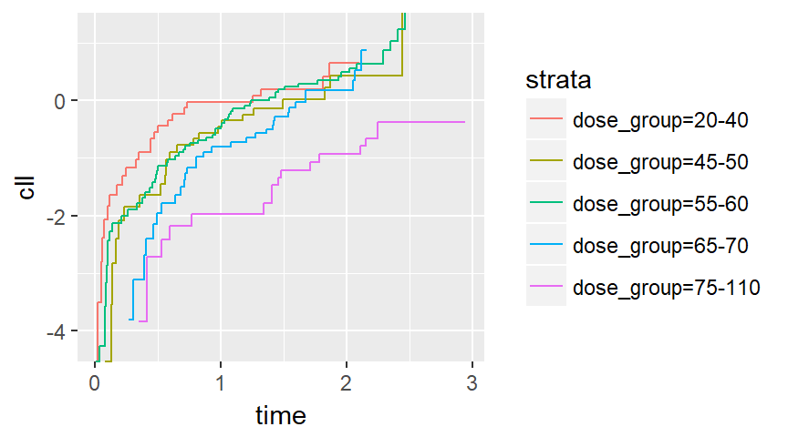
Complementary log-log

Slide 16
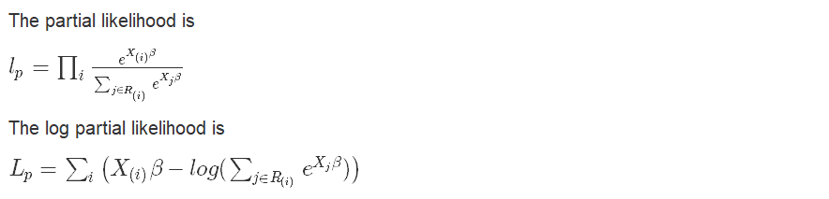
Review of likelihood

Slide 17
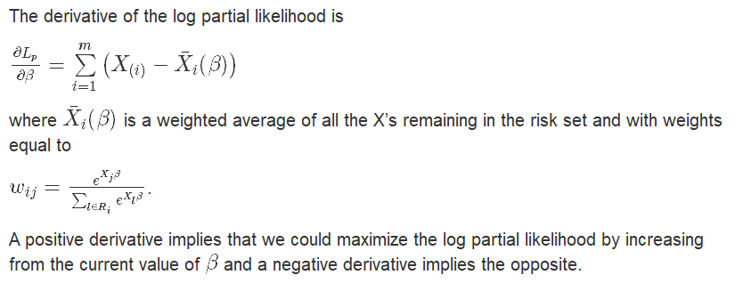
Review of likelihood

Slide 18
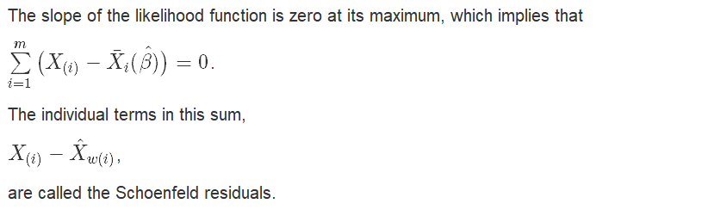
Schoenfeld residuals

Slide 19
Schoenfeld residuals
Interpretation
Normally, the Schoenfeld residuals are standardized.
A time trend is evidence of a violation of the proportional hazards assumption.
Consider this as evidence of an interaction between time and your independent variable.

Slide 20
Schoenfeld residuals
Interpretation
Regions of time where residuals are negative
the hazard ratio is a bit too large.
Regions of time where residuals are positive
the hazard ratio is a bit too small.

Slide 21
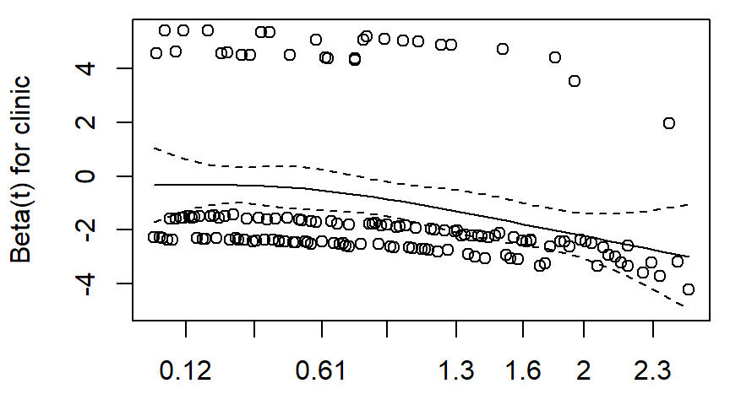
Schoenfeld residuals

Slide 22
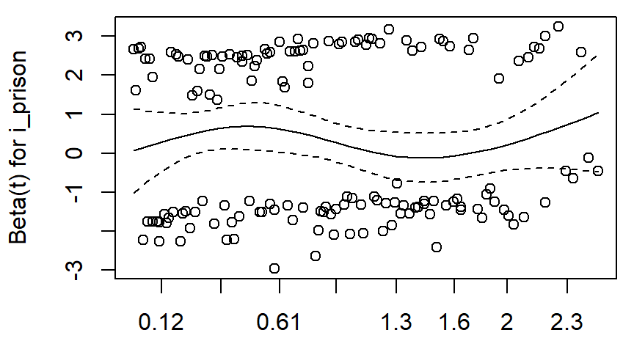
Schoenfeld residuals

Slide 23
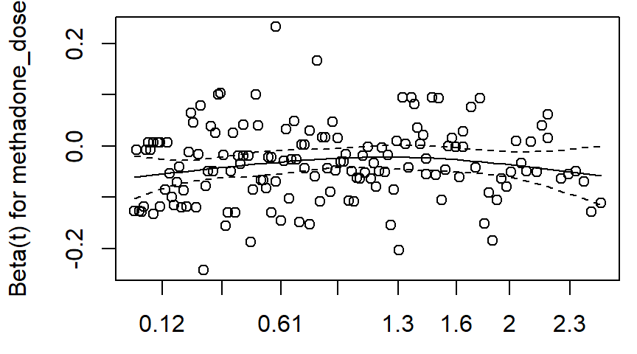
Schoenfeld residuals

Slide 24
Stratified models
The easiest solution for time-varying covariates
Stratification creates a separate baseline hazard for each level of your strata.
Only helpful when the time-varying covariate is a nuisance parameter.

Slide 25
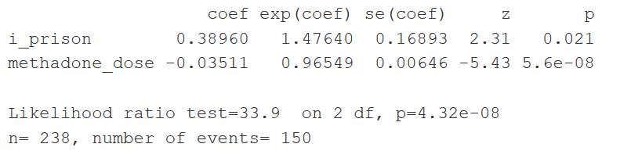
Stratified models

Slide 26
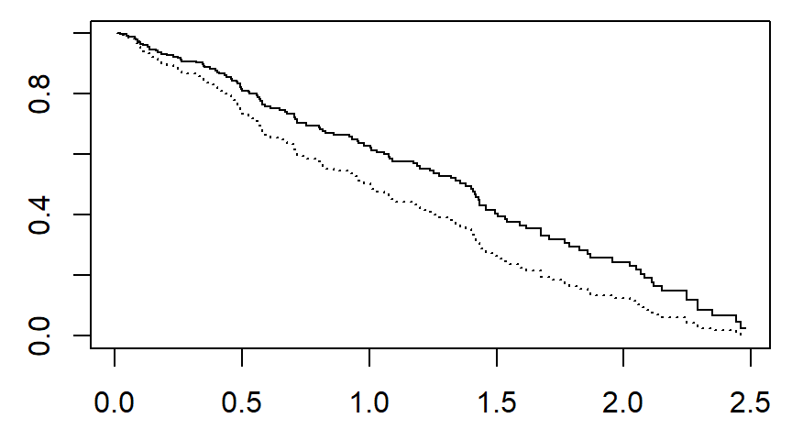
Clinic 1 survivals: solid line is prison_record=no

Slide 27
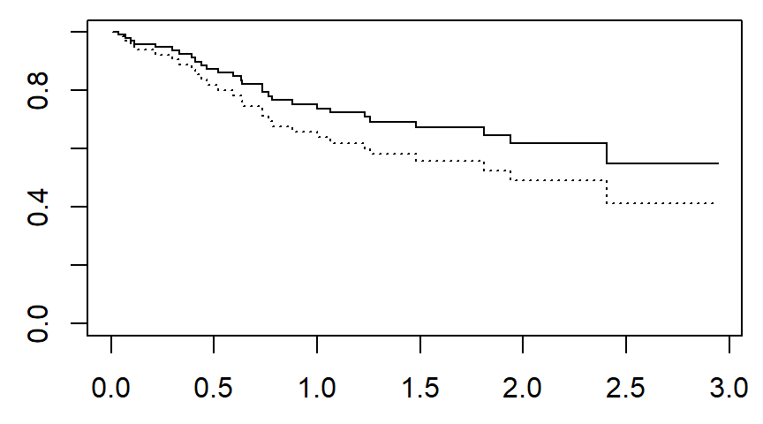
Clinic 2 survivals: solid line is prison_record=no

Slide 28
Time-varying covariates
Interaction with time
You can address problems with non-proportional hazards by creating an interaction involving time.
Also consider interactions involving log(time).

Slide 29
Time-varying covariates
Interaction with time, heroin dataset
coef exp(coef) se(coef) z p
clinic 0.01940 1.01958 0.34717 0.06 0.9554
tt(clinic) -1.10331 0.33177 0.34528 -3.20 0.0014
i_prison 0.38997 1.47693 0.16889 2.31 0.0209
methadone_dose -0.03519 0.96543 0.00644 -5.46 4.7e-08
Likelihood ratio test=76.1 on 4 df, p=1.11e-15
n= 238, number of events= 150

Slide 30
Time-varying covariates
Interaction with time, heroin dataset
beta_clinic beta_interaction t log_hr hr
1 0.019 -1.103 0.0 0.019 1.020
2 0.019 -1.103 0.5 -0.532 0.587
3 0.019 -1.103 1.0 -1.084 0.338
4 0.019 -1.103 1.5 -1.636 0.195
5 0.019 -1.103 2.0 -2.187 0.112
6 0.019 -1.103 2.5 -2.739 0.065

Slide 31
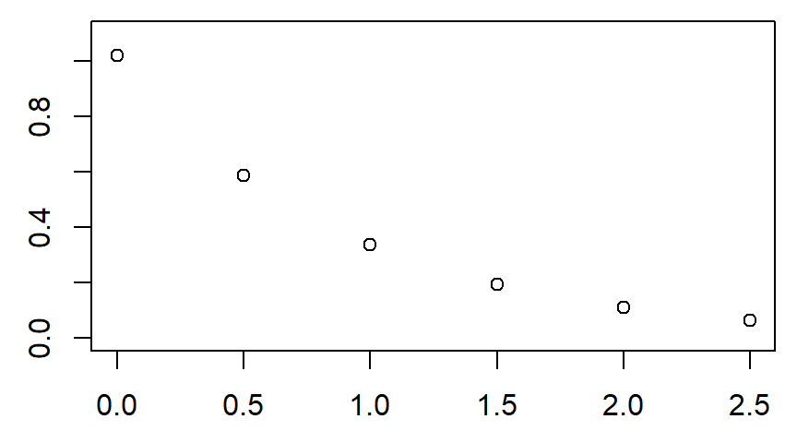
Time-varying covariates

Slide 32
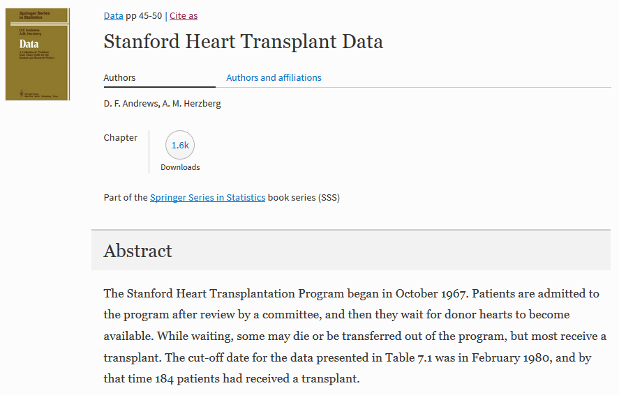
Stanford transplant data

Slide 33
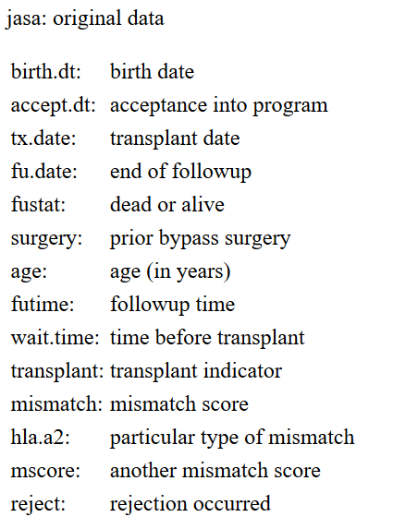
Stanford transplant data

Slide 34
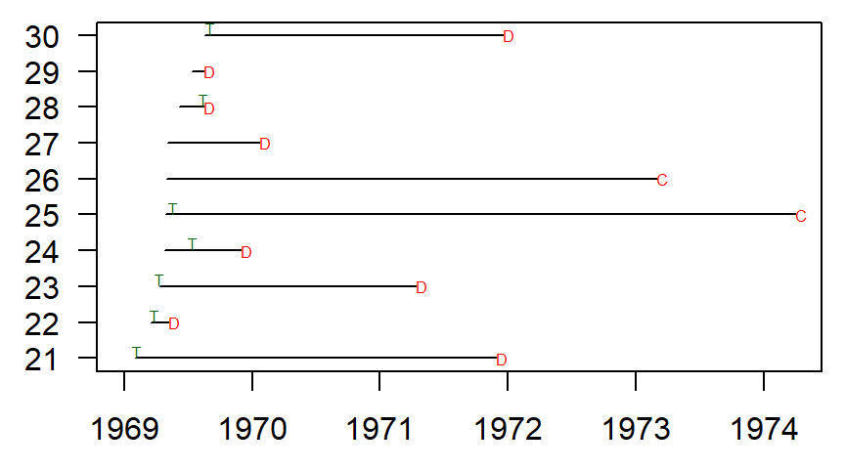
Stanford transplant data, patients 21-30

Slide 35
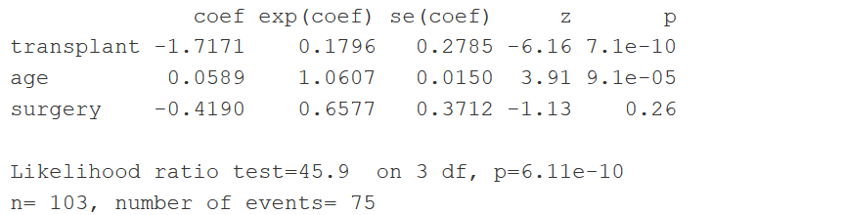
Stanford transplant data, naive analysis

Slide 36
Stanford transplant data
Patient #21
id accept.dt tx.date fu.date fustat transplant
21 1969-02-01 1969-02-08 1971-11-29 1 1
id time1 time2 event transplant
21 7 days 1031 days D 1
id start stop event transplant
21 0 7 0 0
21 7 1031 1 1

Slide 37
Stanford transplant data
Patient #22
id accept.dt tx.date fu.date fustat transplant
22 1969-03-18 1969-03-29 1969-05-07 1 1
id time1 time2 event transplant
22 11 days 50 days D 1
id start stop event transplant
22 0 11 0 0
22 11 50 1 1

Slide 38
Stanford transplant data
Patient #23
id accept.dt tx.date fu.date fustat transplant
23 1969-04-11 1969-04-13 1971-04-13 1 1
id time1 time2 event transplant
23 2 days 732 days D 1
id start stop event transplant
23 0 2 0 0
23 2 732 1 1

Slide 39
Stanford transplant data
Patient #24
id accept.dt tx.date fu.date fustat transplant
24 1969-04-25 1969-07-16 1969-11-29 1 1
id time1 time2 event transplant
24 82 days 218 days D 1
id start stop event transplant
24 0 82 0 0
24 82 218 1 1

Slide 40
Stanford transplant data
Patient #25
id accept.dt tx.date fu.date fustat transplant
25 1969-04-28 1969-05-22 1974-04-01 0 1
id time1 time2 event transplant
25 24 days 1799 days C 1
id start stop event transplant
25 0 24 0 0
25 24 1799 0 1

Slide 41
Stanford transplant data
Patient #26
id accept.dt tx.date fu.date fustat transplant
26 1969-05-01 <NA> 1973-03-01 0 0
id time1 time2 event transplant
26 NA days 1400 days C 0
id start stop event transplant
26 0 1400 0 0

Slide 42
Stanford transplant data
Patient #27
id accept.dt tx.date fu.date fustat transplant
27 1969-05-04 <NA> 1970-01-21 1 0
id time1 time2 event transplant
27 NA days 262 days D 0
id start stop event transplant
27 0 262 1 0

Slide 43
Stanford transplant data
Patient #28
id accept.dt tx.date fu.date fustat transplant
28 1969-06-07 1969-08-16 1969-08-17 1 1
id time1 time2 event transplant
28 70 days 71 days D 1
id start stop event transplant
28 0 70 0 0
28 70 71 1 1

Slide 44
Stanford transplant data
Patient #29
id accept.dt tx.date fu.date fustat transplant
29 1969-07-14 <NA> 1969-08-17 1 0
id time1 time2 event transplant
29 NA days 34 days D 0
id start stop event transplant
29 0 34 1 0

Slide 45
Stanford transplant data
Patient #30
id accept.dt tx.date fu.date fustat transplant
30 1969-08-19 1969-09-03 1971-12-18 1 1
id time1 time2 event transplant
30 15 days 851 days D 1
id start stop event transplant
30 0 15 0 0
30 15 851 1 1

Slide 46
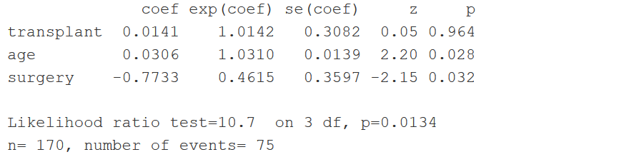
Stanford transplant data, time-varying model

Slide 47
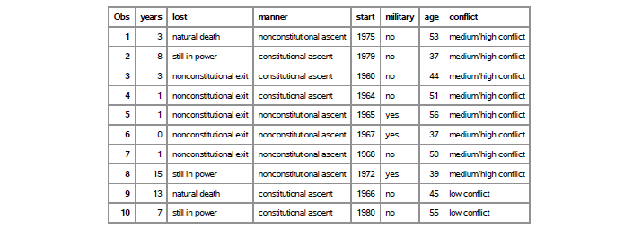
Political leadership changes
Partial listing of data

Slide 48
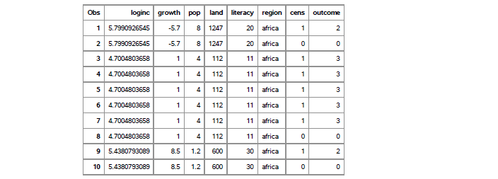
Political leadership changes
Partial listing of data

Slide 49
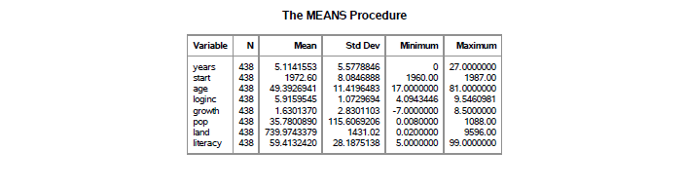
Political leadership changes
Descriptive statistics

Slide 50
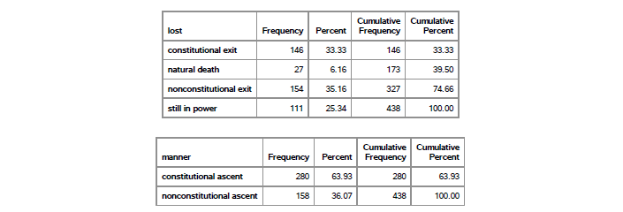
Political leadership changes
Descriptive statistics

Slide 51
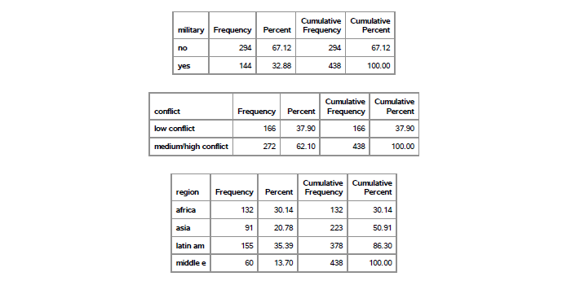
Political leadership changes
Descriptive statistics

Slide 52

Political leadership changes
Descriptive statistics

Slide 53

Political leadership changes
Descriptive statistics

Slide 54
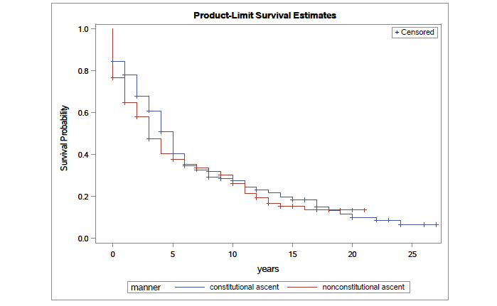
Political leadership changes
Descriptive statistics

Slide 55
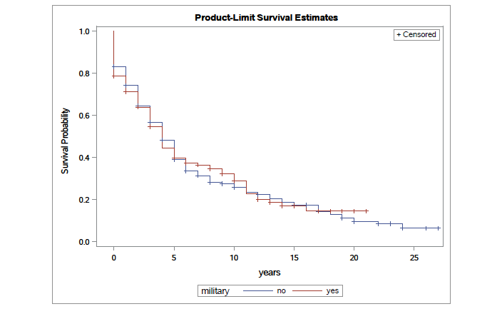
Political leadership changes
Descriptive statistics

Slide 56
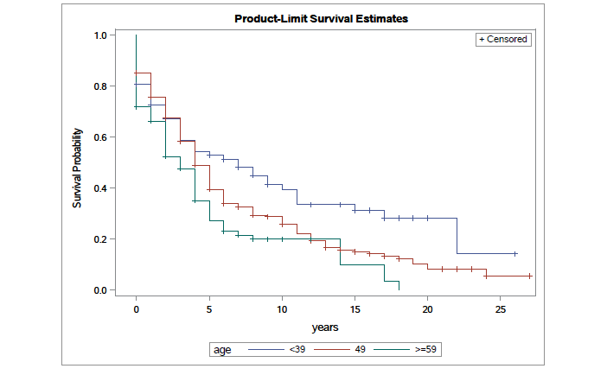
Political leadership changes
Descriptive statistics

Slide 57
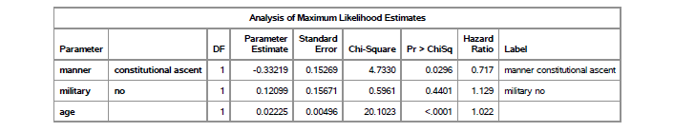
Political leadership changes
Descriptive statistics

Slide 58
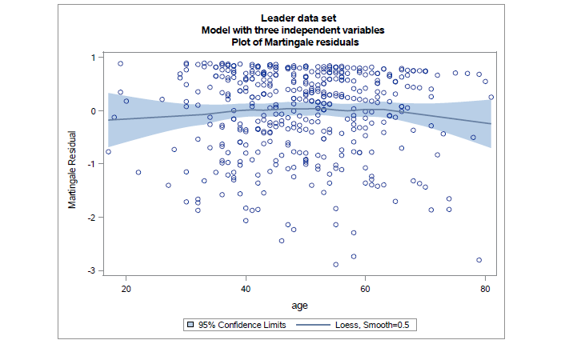
Political leadership changes
Martingale residuals

Slide 59
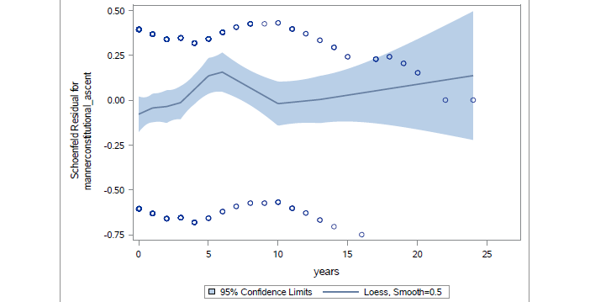
Political leadership changes
Schoenfeld residuals

Slide 60
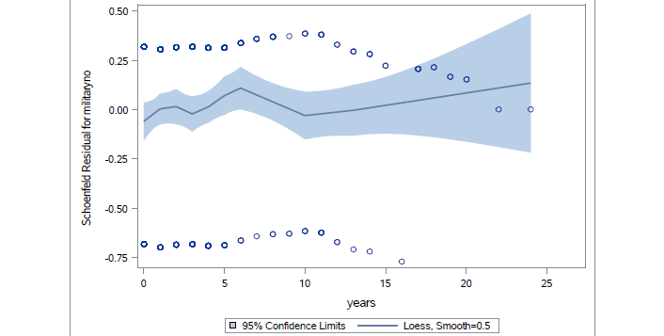
Political leadership changes
Schoenfeld residuals

Slide 61
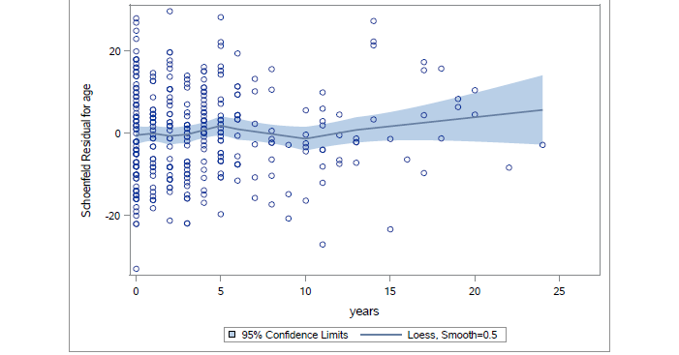
Political leadership changes
Schoenfeld residuals

Slide 62
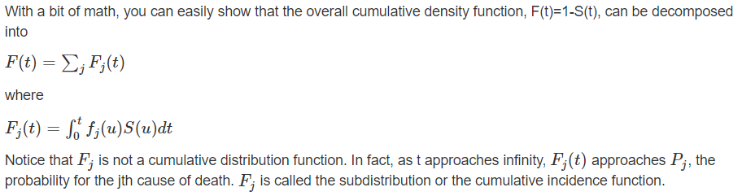
Political leadership changes
Competing risk models

Slide 63
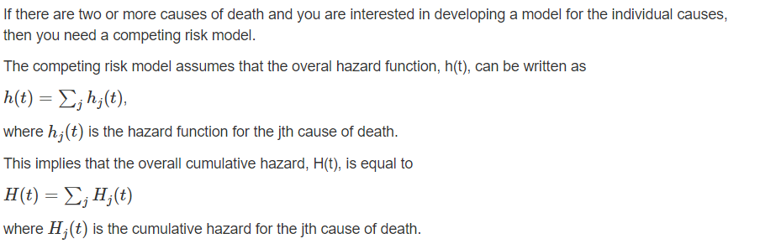
Political leadership changes
Competing risk models

Slide 64
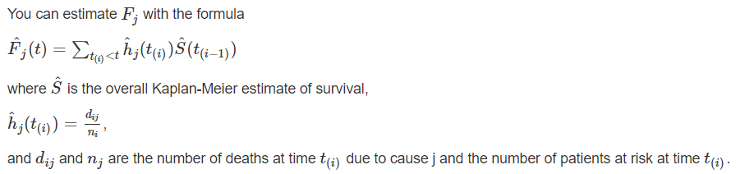
Political leadership changes
Competing risk models

Slide 65
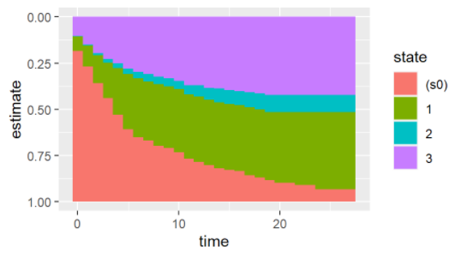
Competing risks – all data
1=constitutional exit, 2=natural death, 3=nonconstitutional exit

Slide 66
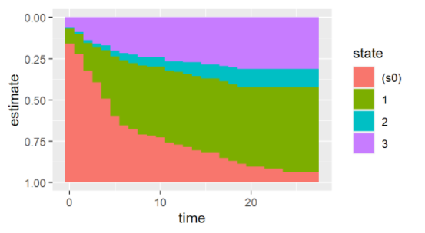
Competing risks – constitutional ascent
1=constitutional exit, 2=natural death, 3=nonconstitutional exit

Slide 67
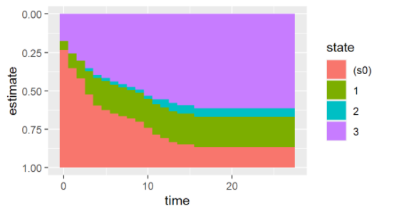
Competing risks – non-constitutional ascent
1=constitutional exit, 2=natural death, 3=nonconstitutional exit

Slide 68
Conclusion
What have you learned today?
There are several ways to check for/control for time varying covariates: patterns in Kaplan-Meier curves, the complementary log-log plot, Schoenfeld Residuals, stratified analysis, and fitting time varying covariates.
You can fit time-varying covariates using start/stop coding or a time transfer function.

